Slide 1
Lecture 04
Processes
National University of
Computer & Emerging Sciences

Slide 2
Process
A computer program in execution on a machine is a process
More formally:
  A Sequential stream of Execution in its own address space

Slide 3
Why use processes?
Why use processes?
  Express concurrency
  Systems have many concurrent jobs going on
  E.g. Multiple users running multiple shells, I/O, ...
General principle of divide and conquer
  Decompose a large problem into smaller ones
  easier to think of well contained smaller problems

Slide 4
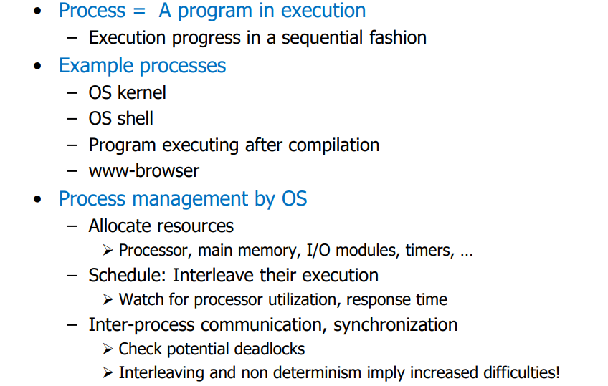
Process

Slide 5
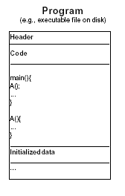
Process =? Program
Program: series of commands (e.g. C statements, assembly commands, shell commands)

Slide 6
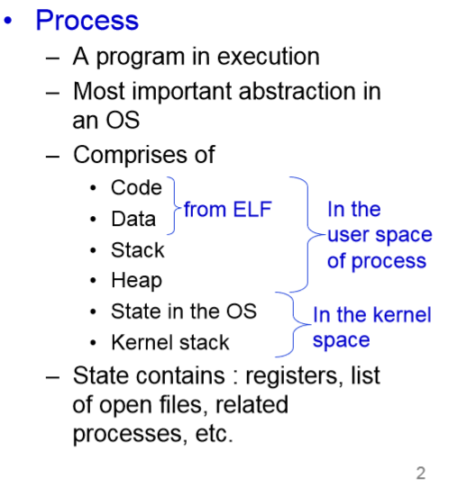
Process

Slide 7
Process
A process consists of multiple parts
Program code, also called text section •
Current activity including program counter, processor registers
Stack containing temporary data – Function parameters, return addresses, local variables
Data section containing global variable
Heap containing memory dynamically allocated during run time

Slide 8

Process in Memory
A list of memory locations from some min (usually 0) to some max that a process can read and write
Notes:
Program code, also called text section
• Current activity including program counter, processor registers
• Stack containing temporary data – Function parameters, return addresses, local variables
• Data section containing global variables
• Heap containing memory dynamically allocated during run time

Slide 9
Program != process
Program: static code + static data
Process: dynamic instantiation of code + data + more
Program process: no 1:1 mapping
  Process has more than code and data
  one program runs many processes
  many processes of same program

Slide 10
Process
A computer program in execution on a machine is a process
More formally:
  A Sequential stream of Execution in its own address space

Slide 11
Process Address Space
A list of memory locations from some min (usually 0) to some max that a process can read and write.
Contains
  the executable program
  program’s data
  Stack
  Associated with a process is a set of registers e.g. PC,SP and other information to run the program.

Slide 12
CPU State
CPU registers contain the current state
  1. Processor Status Word (PSW): includes bits
2. Instruction Register (IR):
3. Program Counter (PC):
4. Stack Pointer (SP):
5. General purpose registers:

Slide 13
Environment
Contains the relationships with other entities
A process does not exist in a vacuum
It typically has connections with other entities, such as
  A terminal where the user is sitting.
  Open files
  Communication channels to other processes, possibly on other machines.

Slide 14
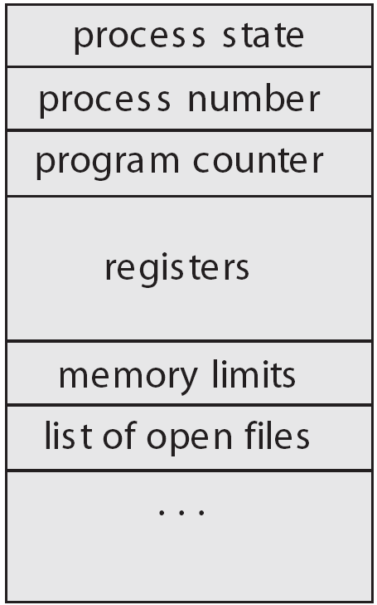
Process Control Block
The OS keeps all the data it needs about a process in the process control block (PCB)
Thus another definition of a process:
  “the entity described by a PCB”
This includes many of the data items described above, or at least pointers to where they can be found
  e.g. for the address space

Slide 15
PCB
PCB is "the manifestation of a process in an operating system”.
Data Structure defined in the operating system kernel containing the information needed to manage a particular process.
It must be kept in an area of memory protected from normal user access.

Slide 16
PCB
In general a PCB includes:
  The identifier of the process (a process identifier, or PID)
  Register values for the process including, notably, the program counter and stack pointer values for the process.
  The address space for the process
  Priority (in which higher priority process gets first preference. e.g., nice value on Unix operating systems)
  Process accounting information, such as when the process was last run, how much CPU time it has accumulated, etc.
  I/O Information (i.e. I/O devices allocated to this process, list of opened files, etc.)

Slide 17
Process Control Block
OS Data Structures
Process Address Space
RAM
CPU
Kernel
User
PSW
State
Memory
Files
Accounting
Priority
User
CPU register storage
text
IR
.
PC
data
SP
heap
General Purpose Registers
stack

Slide 18

CPU Switch From Process to Process

Slide 19
CPU Switch From Process to Process
Switching a process requires
  Saving the state of old process
  Loading the saved state of the new process
This is called Context Switch
Part of OS responsible for switching the processor among the processes is called Dispatcher

Slide 20
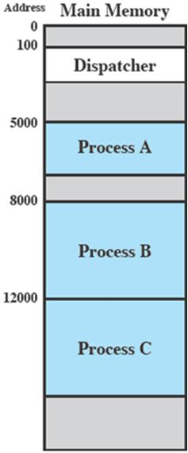
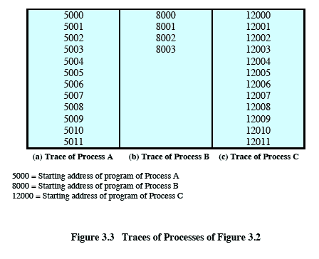

Slide 21
Trace from Processors point of view
Timeout
Timeout
Timeout
I/O
Notes:
Animated slide
Explain the scenario then click for the animation
The shaded areas represent code executed by the dispatcher.
The same sequence of instructions is executed by the dispatcher in each instance because the same functionality of the dispatcher is being executed.
We assume that the OS only allows a process to continue execution for a maximum of six instruction cycles, after which it is interrupted; this prevents any single process from monopolizing processor time.
Animate here
The first six instructions of process A are executed, followed by a time-out and the execution of some code in the dispatcher, which executes six instructions before turning control to process B2.
After four instructions are executed, process B requests an I/O action for which it must wait. Therefore, the processor stops executing process B and moves on, via the dispatcher, to process C.
After a time-out, the processor moves back to process A. When this process times out, process B is still waiting for the
I/O operation to complete, so the dispatcher moves on to process C again.

Slide 22
Process States
At any given time a process is either running or not running
Number of states
  Running
  Not Running
When the OS creates a process, the process is entered into which state?
  Not Running

Slide 23
Two-state process model
Dispatch
Enter
Exit
Not
running
Running
Pause
Number of processes Running at a particular time?
Number of processes Not Running at a particular time?
Data Structure?
Processes that are Not Running at a particular time should be kept in some sort of a queue

Slide 24
Two-state process model
Processor
Queue
Enter
Dispatch
Exit
Pause
Dispatcher is now redefined:
    Moves processes to the waiting queue
    Remove completed/aborted processes
    Select the next process to run

Slide 25
How process state changes1
Ready
Ready
Ready
➔ a := 1
b := a + 1
c := b + 1
read a file
a := b - c
c := c * b
b := 0
➔ a := 1
read a file
b := a + 1
c := b + 1
a := b - c
c := c * b
b := 0
➔ a := 1
b := a + 1
c := b + 1
a := b - c
c := c * b
b := 0
c := 0

Slide 26
How process state changes2
Running
Ready
Ready
➔ a := 1
b := a + 1
c := b + 1
read a file
a := b - c
c := c * b
b := 0
➔ a := 1
read a file
b := a + 1
c := b + 1
a := b - c
c := c * b
b := 0
➔ a := 1
b := a + 1
c := b + 1
a := b - c
c := c * b
b := 0
c := 0
a := 1
➔ b := a + 1
c := b + 1
read a file
a := b - c
c := c * b
b := 0
a := 1
b := a + 1
➔ c := b + 1
read a file
a := b - c
c := c * b
b := 0
Timeout

Slide 27
How process state changes3
Ready
Running
Ready
a := 1
b := a + 1
c := b + 1
➔ read a file
a := b - c
c := c * b
b := 0
➔ a := 1
read a file
b := a + 1
c := b + 1
a := b - c
c := c * b
b := 0
➔ a := 1
b := a + 1
c := b + 1
a := b - c
c := c * b
b := 0
c := 0
a := 1
➔ read a file
b := a + 1
c := b + 1
a := b - c
c := c * b
b := 0
I/O

Slide 28
How process state changes4
Ready
Blocked
Running
a := 1
b := a + 1
c := b + 1
➔ read a file
a := b - c
c := c * b
b := 0
a := 1
➔ read a file
b := a + 1
c := b + 1
a := b - c
c := c * b
b := 0
➔ a := 1
b := a + 1
c := b + 1
a := b - c
c := c * b
b := 0
c := 0
a := 1
➔ b := a + 1
c := b + 1
a := b - c
c := c * b
b := 0
c := 0
a := 1
b := a + 1
➔ c := b + 1
a := b - c
c := c * b
b := 0
c := 0
Timeout

Slide 29
How process state changes5
Running
Blocked
Ready
a := 1
b := a + 1
c := b + 1
➔ read a file
a := b - c
c := c * b
b := 0
a := 1
➔ read a file
b := a + 1
c := b + 1
a := b - c
c := c * b
b := 0
a := 1
b := a + 1
c := b + 1
➔ a := b - c
c := c * b
b := 0
c := 0
I/O

Slide 30
How process state changes6
Blocked
Blocked
Running
The Next Process to Run cannot be simply selected from the front
a := 1
b := a + 1
c := b + 1
➔ read a file
a := b - c
c := c * b
b := 0
a := 1
➔ read a file
b := a + 1
c := b + 1
a := b - c
c := c * b
b := 0
a := 1
b := a + 1
c := b + 1
➔ a := b - c
c := c * b
b := 0
c := 0

Slide 31
How process state changes7
Blocked
Blocked
Running
a := 1
b := a + 1
c := b + 1
➔ read a file
a := b - c
c := c * b
b := 0
a := 1
➔ read a file
b := a + 1
c := b + 1
a := b - c
c := c * b
b := 0
a := 1
b := a + 1
c := b + 1
➔ a := b - c
c := c * b
b := 0
c := 0
a := 1
b := a + 1
c := b + 1
a := b - c
➔ c := c * b
b := 0
c := 0
Suppose the Green process finishes I/O

Slide 32
How process state changes8
Blocked
Ready
Running
a := 1
b := a + 1
c := b + 1
➔ read a file
a := b - c
c := c * b
b := 0
a := 1
read a file
➔ b := a + 1
c := b + 1
a := b - c
c := c * b
b := 0
a := 1
b := a + 1
c := b + 1
➔ a := b - c
c := c * b
b := 0
c := 0
a := 1
b := a + 1
c := b + 1
a := b - c
➔ c := c * b
b := 0
c := 0
a := 1
b := a + 1
c := b + 1
a := b - c
c := c * b
➔ b := 0
c := 0
Timeout

Slide 33
How process state changes9
Blocked
Running
Ready
a := 1
b := a + 1
c := b + 1
➔ read a file
a := b - c
c := c * b
b := 0
a := 1
read a file
➔ b := a + 1
c := b + 1
a := b - c
c := c * b
b := 0
a := 1
b := a + 1
c := b + 1
a := b - c
c := c * b
b := 0
➔ c := 0
a := 1
read a file
b := a + 1
➔ c := b + 1
a := b - c
c := c * b
b := 0
a := 1
read a file
b := a + 1
c := b + 1
➔ a := b - c
c := c * b
b := 0
Timeout

Slide 34
Problem in Two-state Process model
A process may be waiting for I/O request
A single queue for both the ready to run and waiting processes
The dispatcher cannot simply select the process at the front, it can be a busy process
In the worst case, it has to scan the whole queue to find the next process to run
Solution?
Split the Not Running state to:
  Waiting, Ready

Slide 35
Five-state Process Model
Running: currently being run
Ready: ready to run
Blocked: waiting for an event (I/O)
New: just created, not yet admitted to set of run-able processes
Exit: completed/error exit

Slide 36
Five-state Process Model
Dispatch
Release
New
Admit
Ready
Running
Exit
Time-out
Event occurs
Event wait
Blocked

Slide 37

Diagram of Process State

Slide 38
Blocked Queues
Timeout
Ready queue
Processor
Admit
Dispatch
Release
Event occurs
Blocked queue/ Event queue
Event wait
Running process
Ready process
Blocked process
Further Enhancement:
A separate queue holds the
processes waiting for different event.

Slide 39

Representation of Process Scheduling
Queueing diagram represents queues, resources, flows

Slide 40
Schedulers
Short-term scheduler (or CPU scheduler) – selects which process should be executed next and allocates CPU
  Sometimes the only scheduler in a system
  Short-term scheduler is invoked frequently (milliseconds) ⇒ (must be fast)
Long-term scheduler (or job scheduler) – selects which processes should be brought into the ready queue
  Long-term scheduler is invoked infrequently (seconds, minutes) ⇒ (may be slow)
  The long-term scheduler controls the degree of multiprogramming
Processes can be described as either:
  I/O-bound process – spends more time doing I/O than computations, many short CPU bursts
  CPU-bound process – spends more time doing computations; few very long CPU bursts
Long-term scheduler strives for good process mix

Slide 41

Addition of Medium Term Scheduling
Medium-term scheduler can be added if degree of multiprogramming needs to decrease
  Remove process from memory, store on disk, bring back in from disk to continue execution: swapping

Slide 42
Scheduling Queues
The queues are generally stored as linked lists
A queue header points to the first and the final PCB’s in the list
We extend each PCB to include a pointer field that points to the next PCB in the ready queue

Slide 43

Scheduling Queues

Slide 44
Schedulers
Short term Scheduler or CPU Scheduling
  Which program is to be run next
Long term Scheduler or Job Scheduler
  Which ready jobs should be brought to memory
  May need to invoke only when a process leaves the system
  Must make a careful selection

Slide 45
Process Types
Most processes can be described as either I/O bound or CPU bound
I/O bound:
  Spends more of its time doing I/O than doing computations
CPU bound:
  Spends more of its time doing computations than doing I/O
If all processes are I/O bound,
  The ready queue will almost always be empty
If all processes are CPU bound,
  The I/O waiting queue will almost always be empty, devices will go unused
  System will again be unbalanced

Slide 46
Process Types
Sometimes OS may swap a blocked process to disk to free up more memory
Or to improve process mix
This is called Swapping

